Slide 1
怎样更好的了解竞争对手
—— 梅花网媒体监测你的工作伙伴

Slide 2
菩提子和大超人都是某广告公司员工，菩提子是刚入职不久的小AE，而大超人则已是公司元老，并将负责指导菩提子的工作。。。。。
老大，今天我的工作安排是什么呀？？
我看看啊 ==
额，今天啊首先要查阅下近期我们服务的品牌竞品有没有新的广告创意投放，如果有投放，要告诉我他们都投放在哪些渠道了，创意最好能整理个PPT给我。喔，还有最重要的，最好能拿到他们投放广告的刊例价。。。有不明白的问我啊 ☺
额！！老大，那我今天要先看杂志，再整理扫描，再做PPT喔
。。。。。。。。。
亲，请登录梅花网情报站，那里会给帮你解决一切~~~

Slide 3
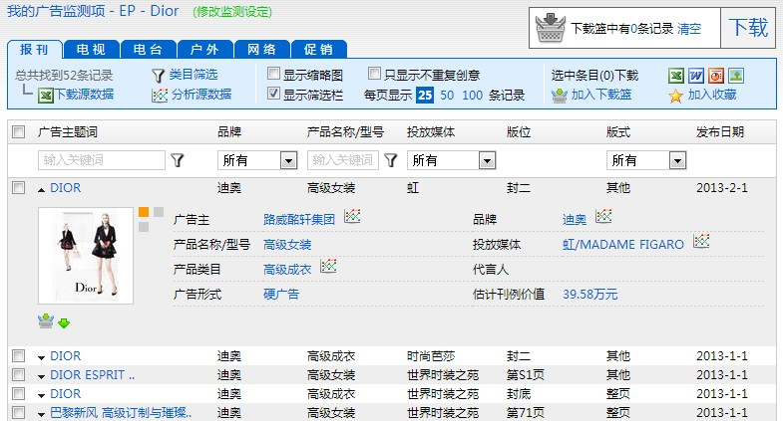
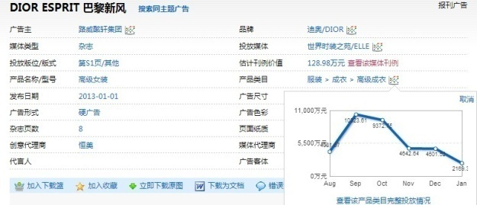
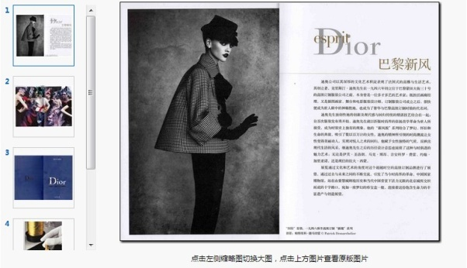
菩提子按大超人的提示，尝试登录梅花网开启一天的工作。。
全媒体喔亲
1
菩提子登录到情报站页面后，打开之前设置好的监测项，找到Dior，并点击查阅近期一个月内广告列表。结果显示近期一个月Dior服装在电视、电台和促销都未投放过广告，大部分广告都投放在了平面、户外和网络。
2
点击每个广告，能找到更多细节喔
投放刊例趋势

Slide 4
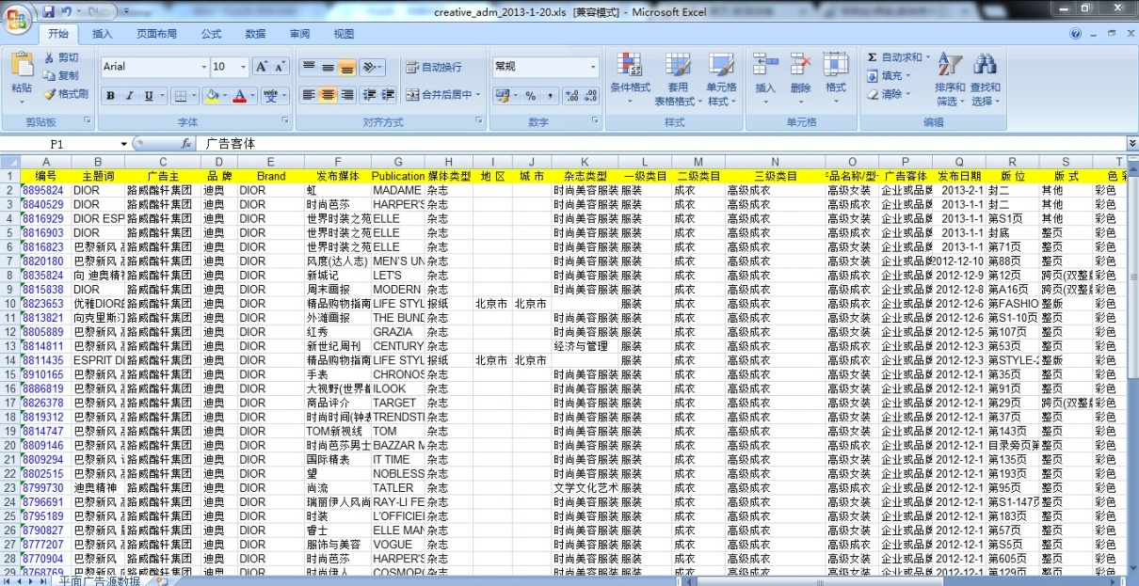
3
回到监测项页面，勾选目标广告，轻松实现PPT报告下载（同时还可下载Word、Excel源数据和Jpg原图模式）；同样勾选好所需广告，直接下载出来的Excel源数据，只需一张数据透视表，所需刊例价、投放渠道、频次一目了然
PPT直接下载出成型报告
源数据可做更多维度分析

Slide 5
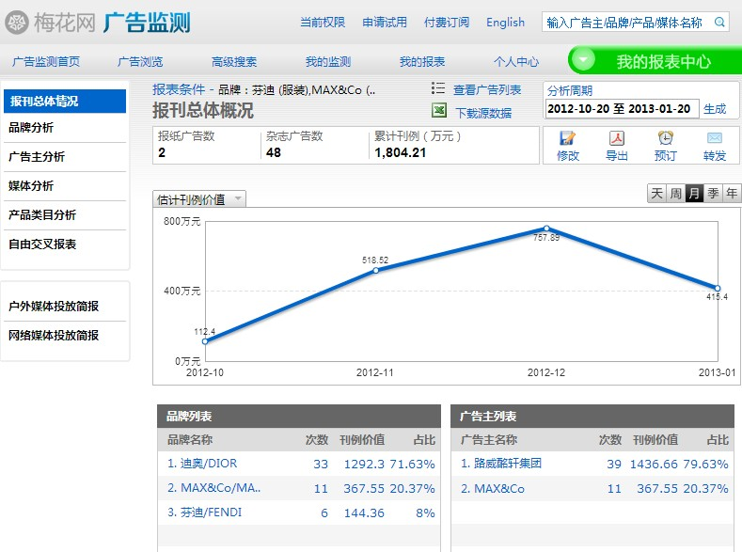
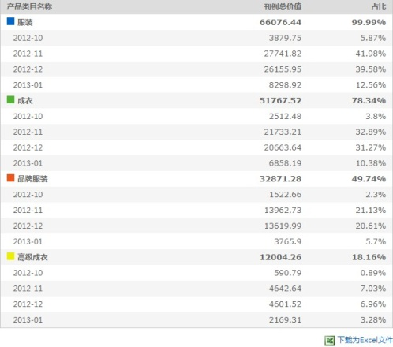
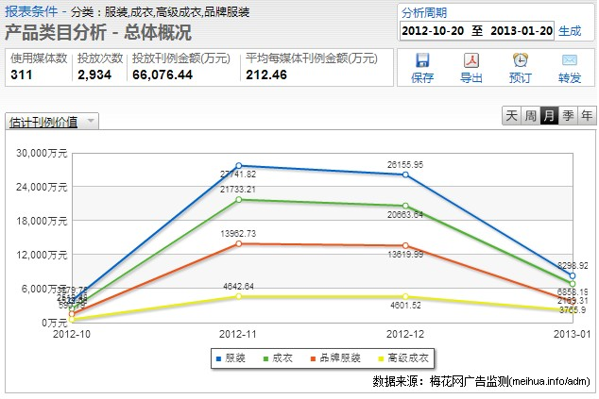
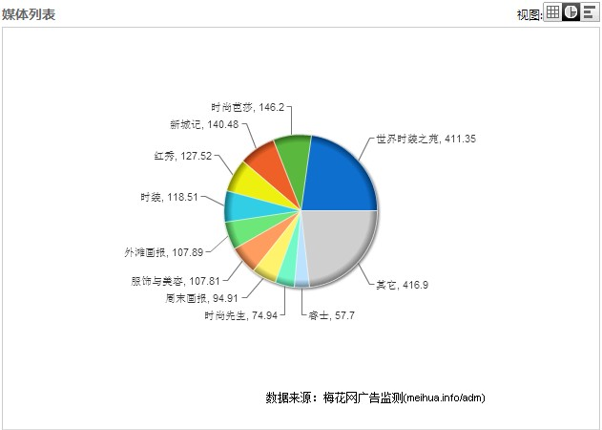
我的报表功能，还可轻松实现在线制作广告投放报告，不用下载源数据，可直接生成PDF报告
4
打开我的报表，找到事先设置好的竞品监测项，点击进入报表条件页面，选择所要分析的时间段，投放总体情况映入眼帘，还可从品牌、广告主、媒体、产品类目等不同角度了解投放策略
多维度分析结果迅速呈现

Slide 6
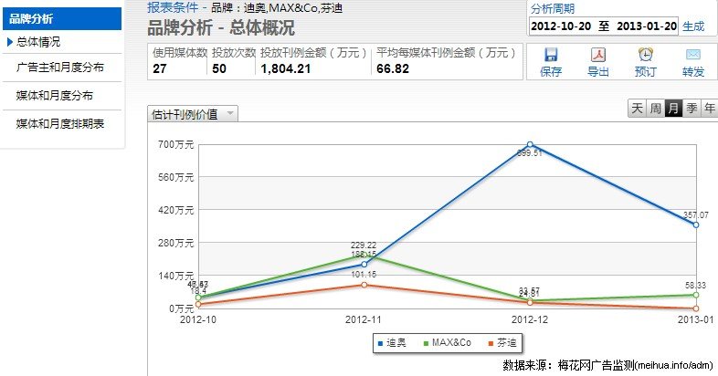
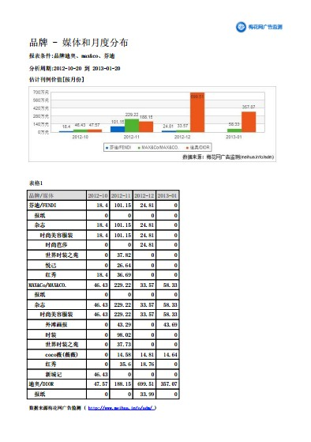
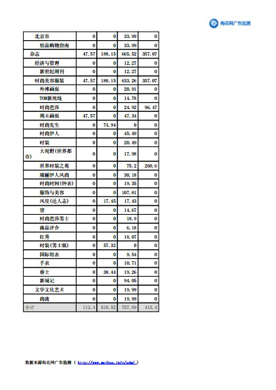
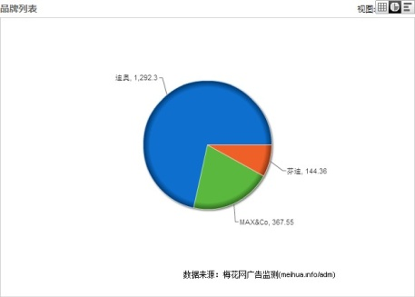
对关注竞品进行对比分析
5
选择品牌分析，勾选所要分析的品牌，品牌在所选期间段的广告投放频次、选投媒体数以及投放的刊例金额均能直接显示
PDF成型报告直接生成

Slide 7
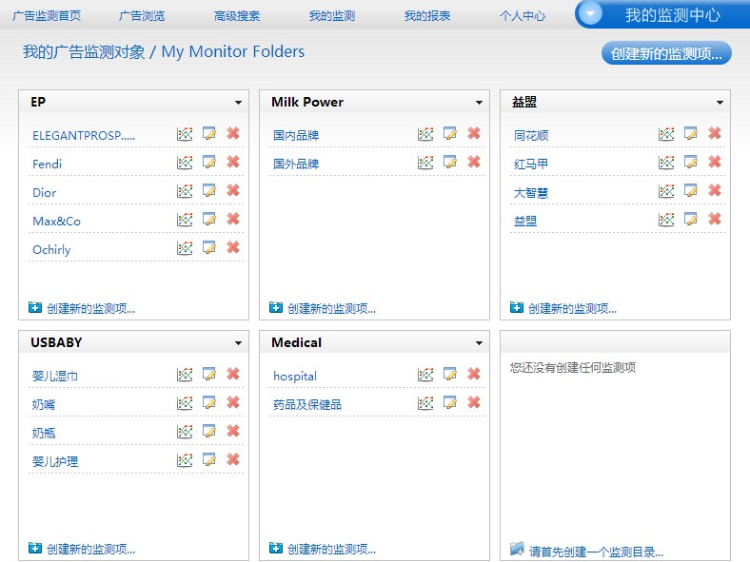
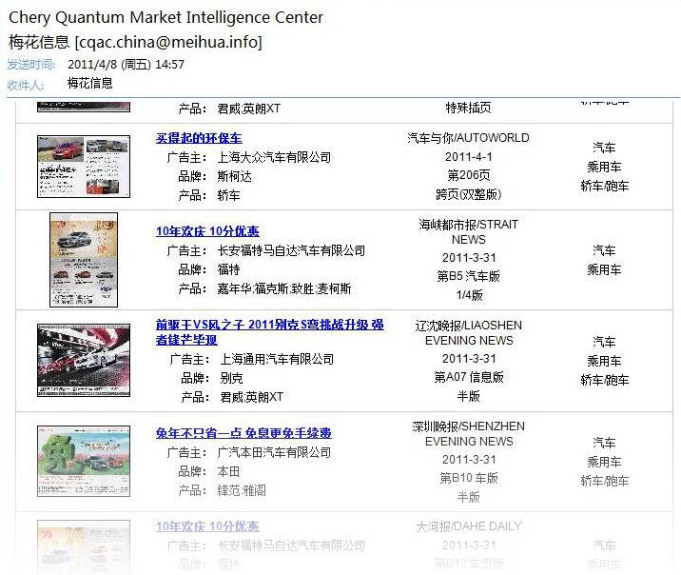
每日邮件提醒
让你成为广告达人
加入每日邮件预定

Slide 8
@上海
@北京
@深圳
@杭州
在线获取免费试用
访问新浪微博获取梅花网最新资讯 http://t.sina.com.cn/meihua2002

Slide 9
Learn More About Your Competitors
MeiHua Media Monitoring -- Your Choice

Slide 10
Putizi, a freshman, and Super Man, a company veteran of some ad agency. Super Man is here to help Putizi with his new job.
Hi Boss, Super Man! Any clue to my job today?
Well, check out if there are any creative ads from our customers’ competitors, find out the channels they ran ads, and make a PPT file with all the creative ads. Above all, getting the price of each ad would be appreciated. Any questions, pls let me know.
Got it, Super Man! I will begin with reading magazines, sorting out and scanning useful information and then, make a PPT.
Pls log on Information Station and you’ll find everything you need.

Slide 11
Putizi then logged on the above-mentioned website and started his work.
Full Media~~
1
He targeted Dior via the already-set monitoring item, clicked and went through the ad list for the last month, finding that Dior ran ads via print, outdoor and network media instead of TVs, broadcasting stations and promotion activities
2
Pls click each ad item for more details
channels trend

Slide 12
3
Back to the monitoring page, check the target ad to download its PPT report (source data in the form of Word and Excel as well as JPG model are also available), you’ll find all the prices, running channels and frequency for the ad just on one excel sheet.
Download PPT to get the final report
Analyze source data in different dimensions

Slide 13
The “Report Function” button helps conclude an ad service report without downloading source data, and it will generate a PDF report automatically.
4
Click “My Report” button, turn to the “report terms” page after finding the preset competitors’ monitoring items, select a certain period for monitoring, and you’ll have the entire ad service information in your sight. In addition, you can also learn advertising strategies via brands, advertisers, media and product categories.
Advertising strategies jump into your eyes with a clear list

Slide 14
Product & Marketing Research
5
Select the “Brand Analysis” button and check targeted brands, information concerning advertising frequency, on which kind of media ads are put as well as ads prices within a certain period of time will be shown automatically.
Generate a final PDF report automatically

Slide 15
Daily E-mail Alerts Make You More Resourceful
Daily mail reservation

Slide 16
@Shanghai
@Beijing
@Shenzhen
@Hangzhou
Click here for free online trial
Visit our sina micro-blog for the latest info at: http://t.sina.com.cn/meihua2002

